Slide 1
Find my Library
Abhishek sharma

Slide 2
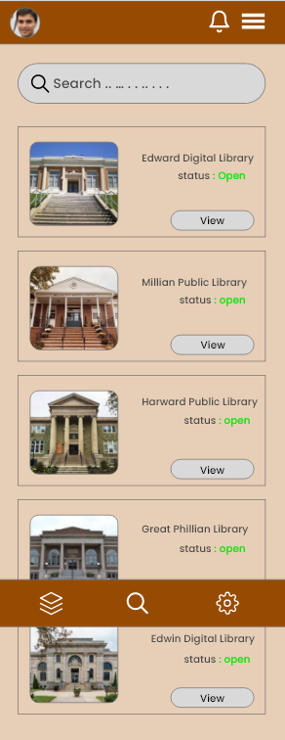
Project overview
The product:
This project is focused on providing good shopping experience.
Project duration:
It took 1week to design the website.

Slide 3
Project overview
The problem:
Difficulty in finding library near them.
The goal:
Provide roadmap to the library.
Provide simple and user friendly app.

Slide 4
Project overview
My role:
Ux designer
Responsibilities:
Wireframing , prototyping, product

Slide 5
User research
Pain point
Personas
Understanding
the user

Slide 6
User research: summary
I conducted interviews and created empathy maps to understand the users I’m designing for and their needs. A primary user group identified through research was working adults who can’t locate and see all the library in their location.
Unmoderated research study is conduced and assumed that user can navigate between different tabs easily.

Slide 7
User research: pain points
1
2
3
Pain point
Pain point
Pain point
Duration it takes to reach at library.
Contact form for enquiry.
Filter option for selecting nearest library.

Slide 8
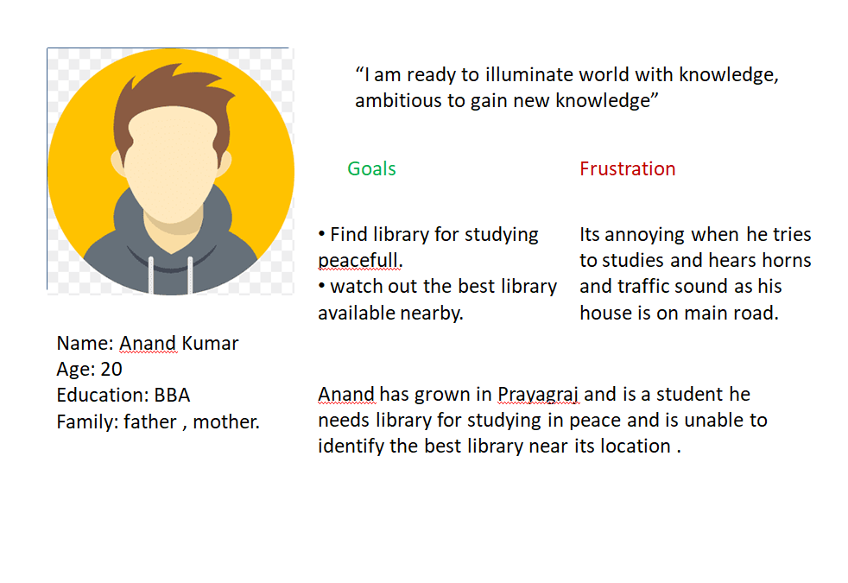
Persona: Anand Kumar
Problem statement:
Anand is a student and need library for studying peacefully because its house is on road and is frustrated from traffic sounds.

Slide 9
Paper wireframes
Digital wireframes
Low-fidelity prototype
Starting
the design

Slide 10
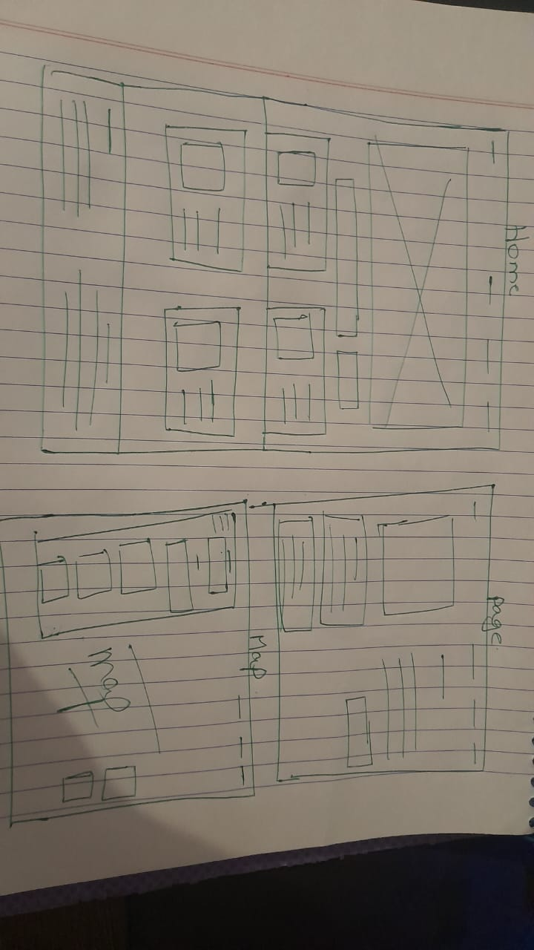
Paper wireframes

Slide 11
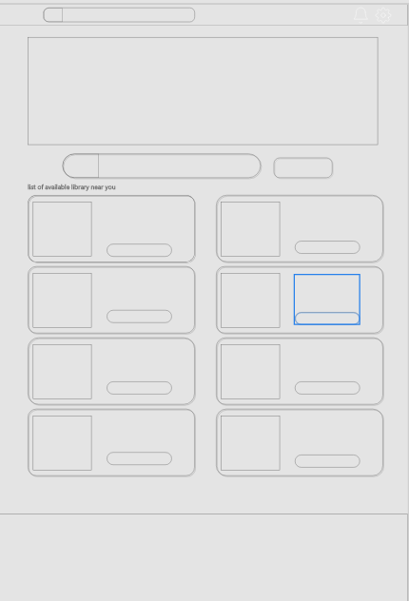
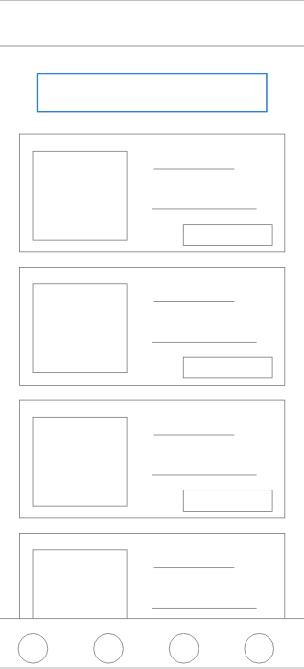
Desktop
Mobile
Digital wireframes

Slide 12
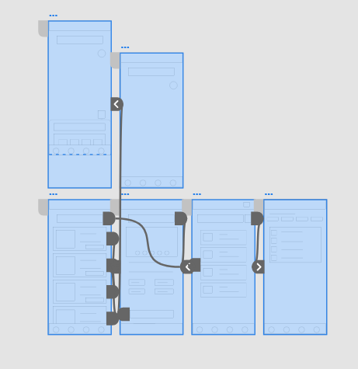
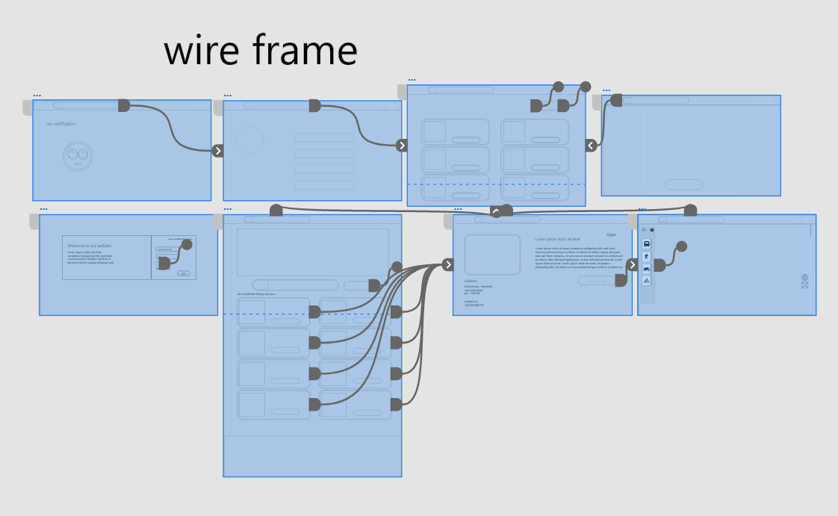
Low-fidelity prototype

Slide 13
Refining
the design
Mockups
High-fidelity prototype
Accessibility

Slide 14
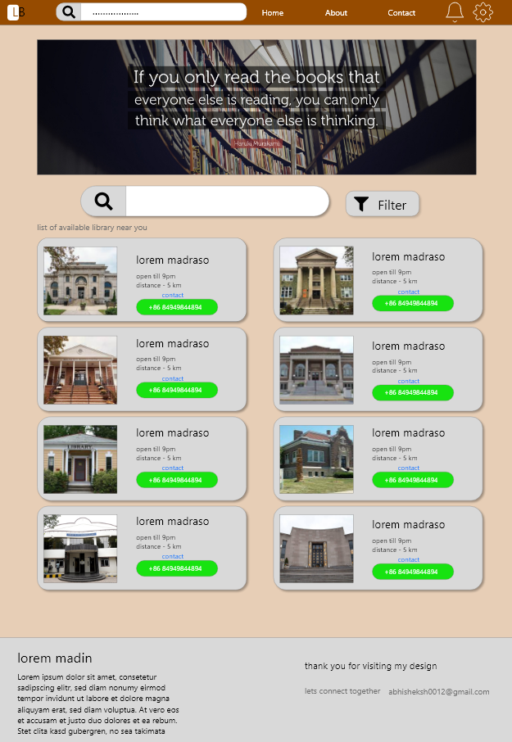
Before usability study
After usability study
Mockups

Slide 15
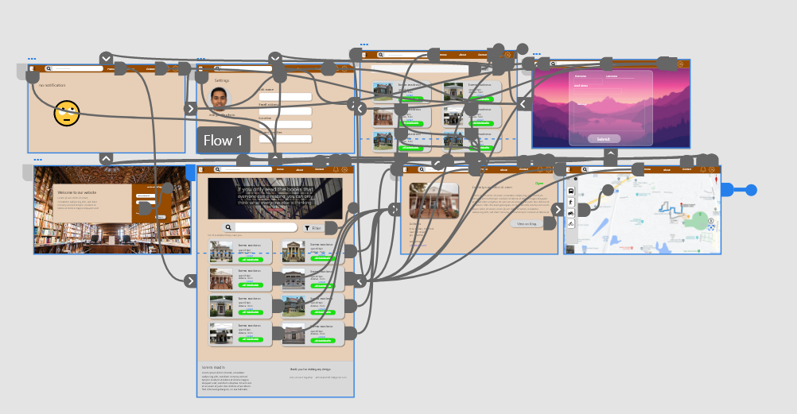
High-fidelity prototype
Screenshot of prototype with connections or prototype GIF

Slide 16
Accessibility considerations
1
2
3
Provided access to users who are vision impaired through adding alt text to images for screen readers.
Used icons to help make navigation easier.
Used image of library to differintiate.

Slide 17
Going forward
Takeaways

Slide 18
Takeaways
Impact:
Helps the people to locate near by library easily.
While designing the Find my Library , I learned that the first ideas for the app are only the beginning of the process. Usability studies and peer feedback influenced each iteration of the app’s designs.

Slide 19
Let’s connect!
Thank you for your time reviewing my work on the Find my Library . If you’d like to see more or get in touch, my contact information is provided below.
Email: abhisheksh0012@gmail.com

Slide 20
Thank you!

